Slide 1

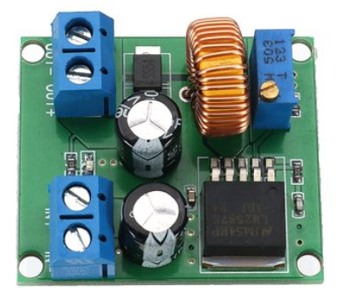
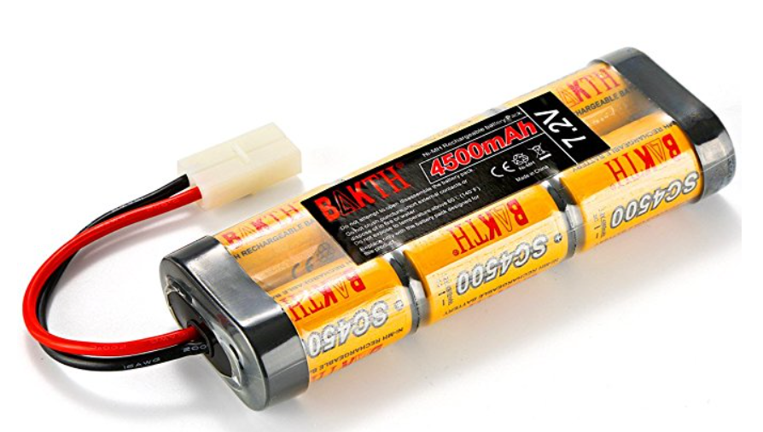
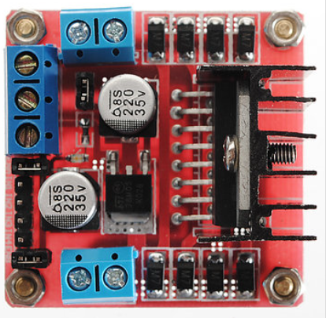
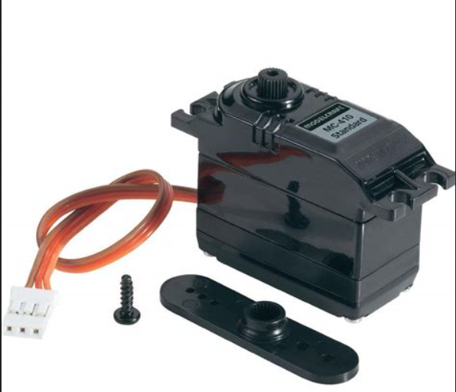
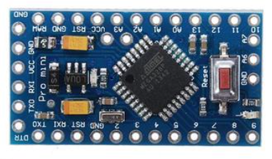
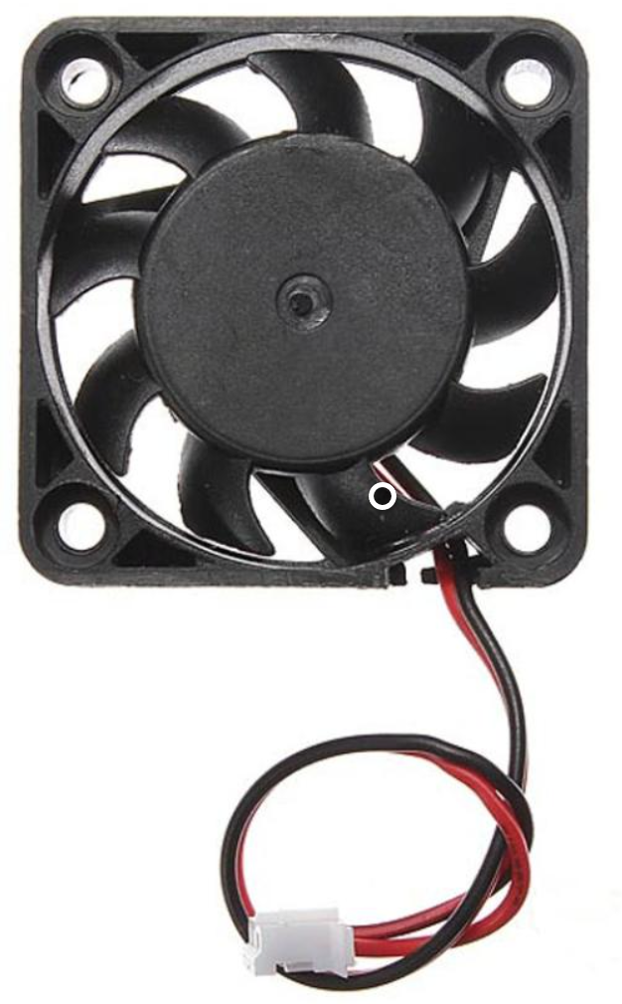
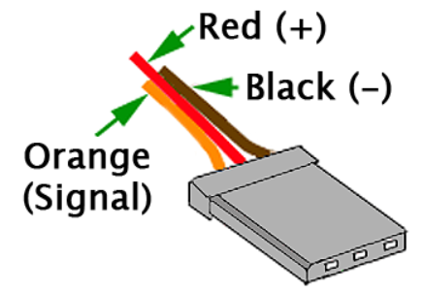
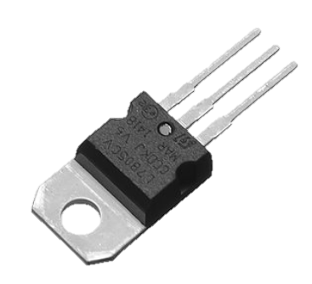
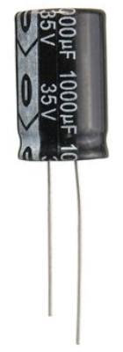
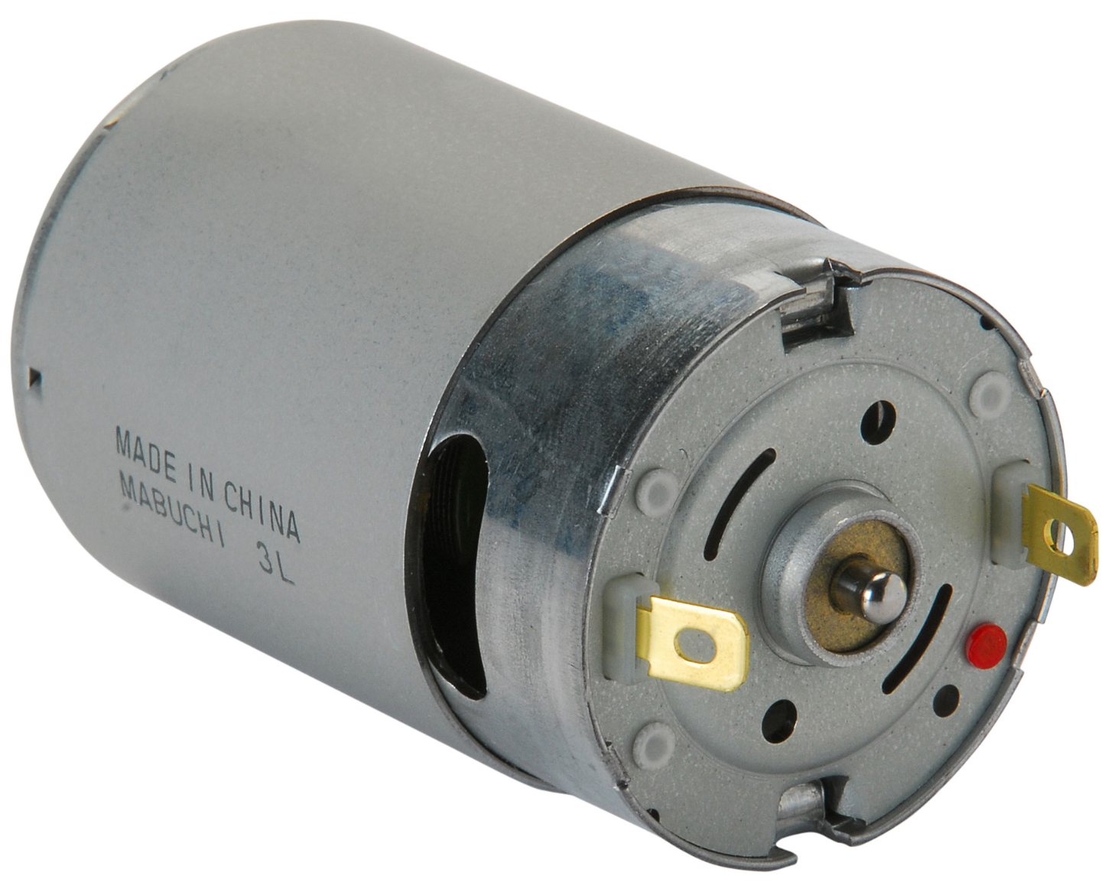
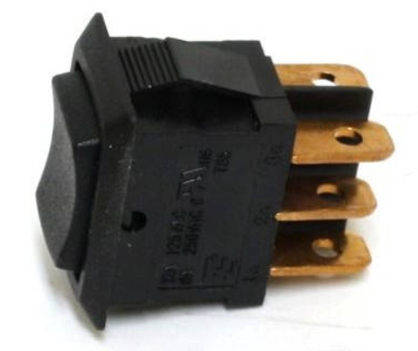
12V
Up converter, regulator 12V output
RockPro64 board from pine64.org
7.2V
4500mA 7.2V battery
Modelcraft MC410 servomotor
Double h-bridge
Cooling fan for h-bridge
3.3V
LM7805
Arduino mini
5V
5V
on/off switch
Motor

Slide 2
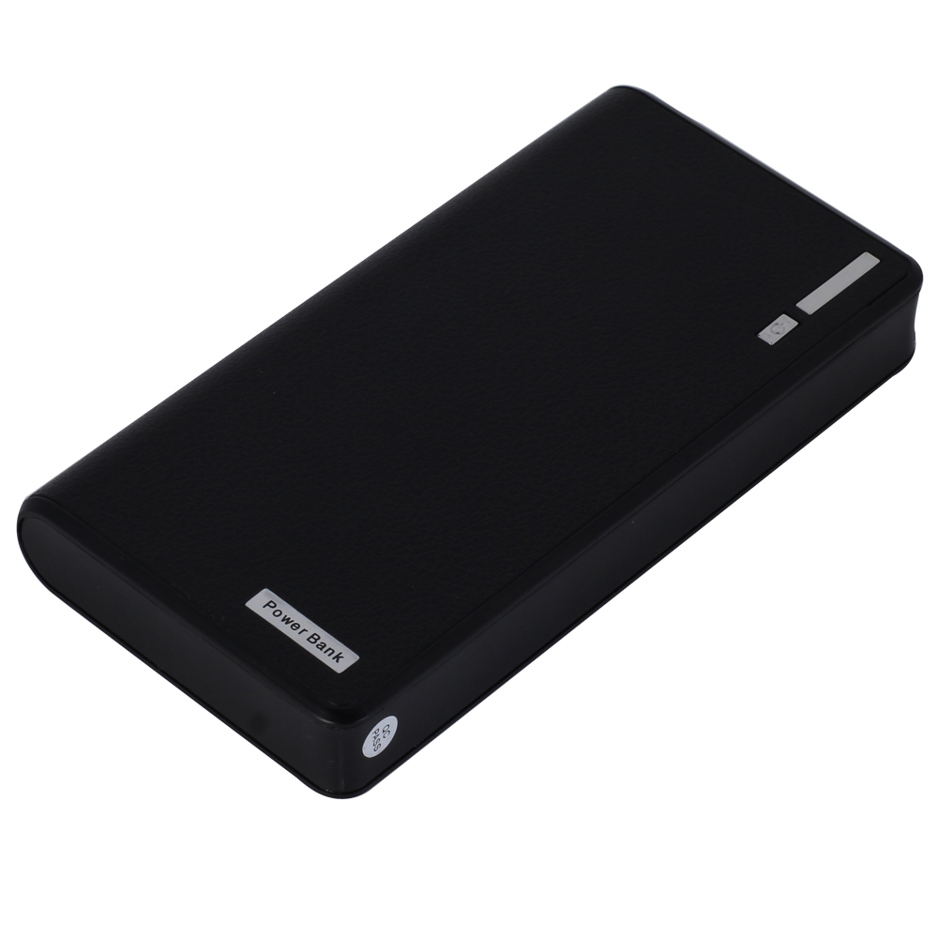
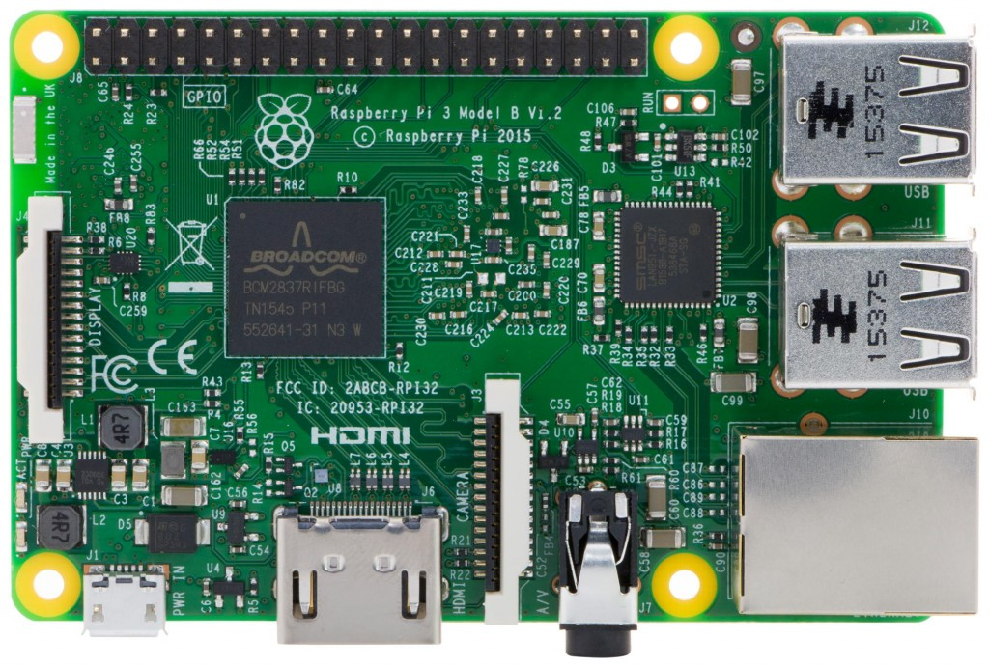
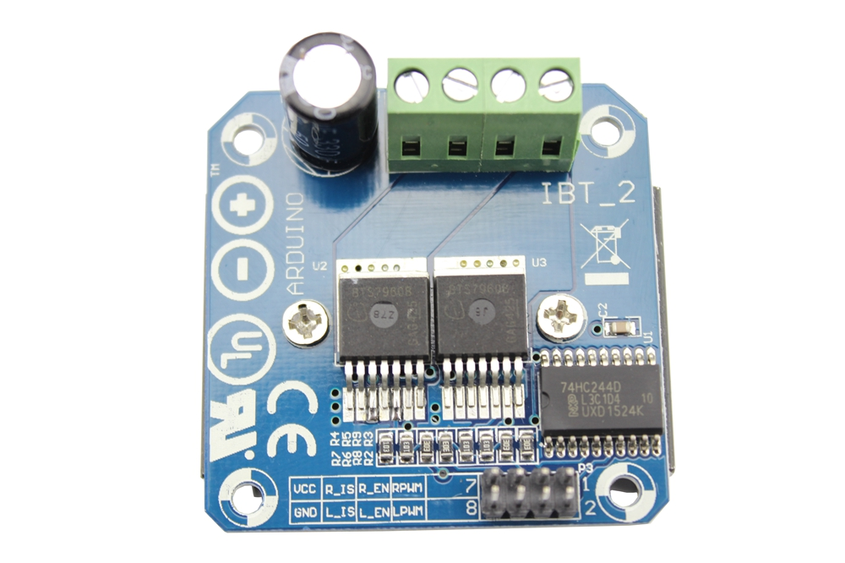
Raspberry Pi 3
5V
Battery pack (power bank)
7.2V
4500mA 7.2V battery
Modelcraft MC410 servomotor
Double h-bridge
5V
LM7805
Arduino mini
5V
on/off switch
5V
Motor

Slide 3
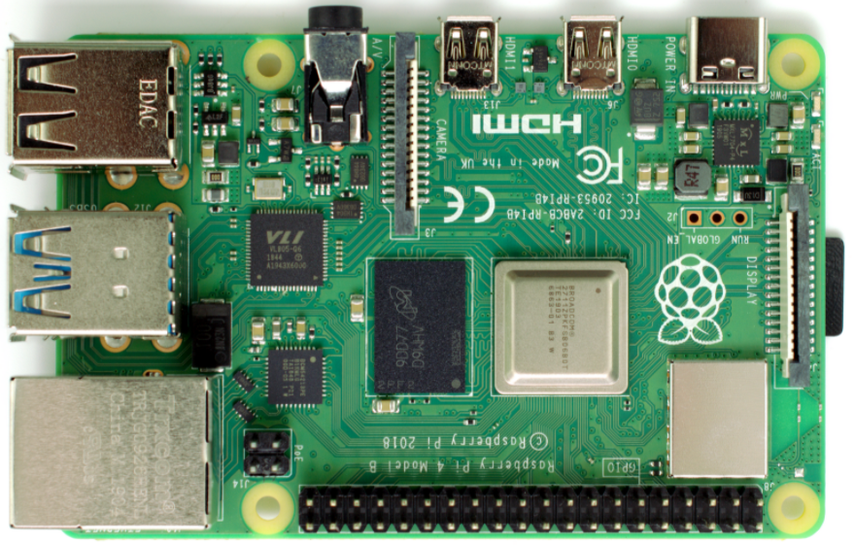
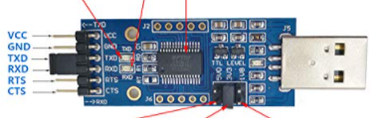
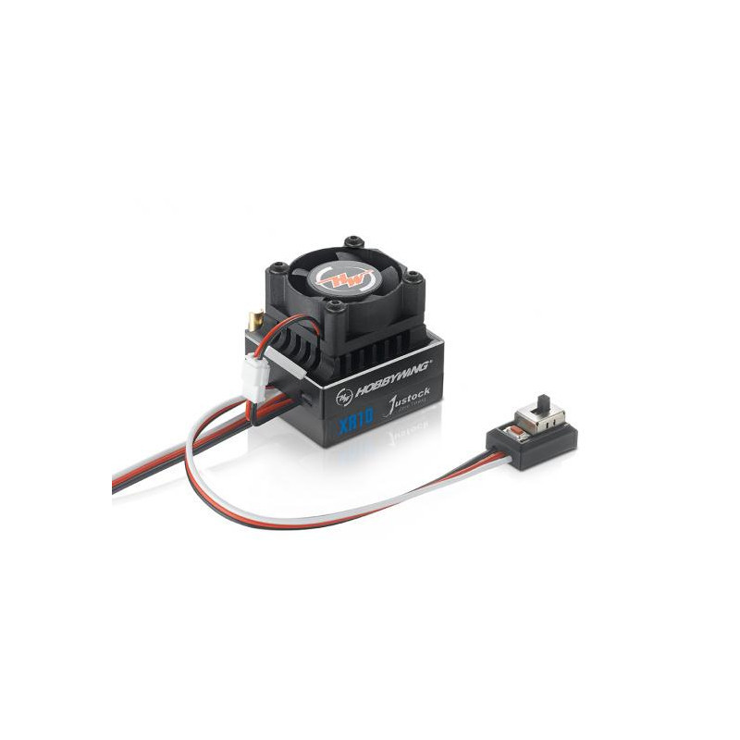
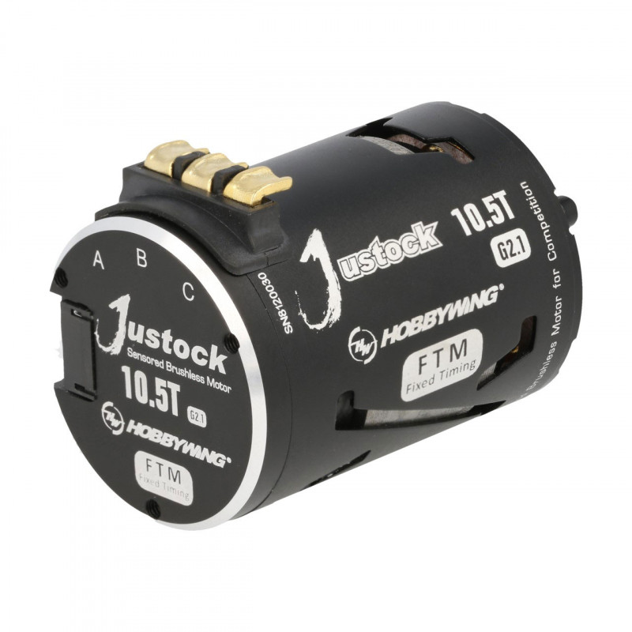
Raspberry Pi 4
Battery pack (power bank)
4500mA 7.2V battery
Servomotor
Arduino mini
GND, C, B, A, tmp, VCC 5v
On/Off +
programming button
6v 2A BEC
Sensor feedback cable
Brushless sensored Motor

